Slide 1
SORTED SET

Slide 2
What is Generic SortedSet<T> Collection
The Generic SortedSet<T> Collection Class in C# is used to store, remove or view elements. SortedSet Collection store the elements in sorted order. That means it stores the element in ascending order and also, and it does not store duplicate elements. So, it is recommended to use the SortedSet collection if you want to store only unique elements in ascending order. This collection is of the generic type collection and hence it belongs to System.Collections.Generic namespace.
It also provides many mathematical set operations, such as intersection, union, and difference. It is a dynamic collection means the size of the SortedSet is automatically increased when new elements are added.

Slide 3
How to create a Generic SortedSet Collection
The Generic SortedSet Collection class in C# provided five constructors that we can use to create an instance of SortedSet. They are as follows:
SortedSet(): It initializes a new instance of the Generic SortedSet class.
SortedSet(IComparer<T> comparer): It initializes a new instance of the Generic SortedSet class that uses a specified comparer
SortedSet(IEnumerable<T> collection): It initializes a new instance of the Generic SortedSet class that contains elements copied from a specified enumerable collection.
SortedSet(IEnumerable<T> collection, IComparer<T> comparer): It initializes a new instance of the Generic SortedSet class that contains elements copied from a specified enumerable collection and that uses a specified comparer.
SortedSet(SerializationInfo info, StreamingContext context): It initializes a new instance of the Generic SortedSet class that contains serialized data. The parameter info specifies the object that contains the information that is required to serialize the Generic SortedSet object and the context parameter specifies the structure that contains the source and destination of the serialized stream associated with the Generic SortedSet object.

Slide 4
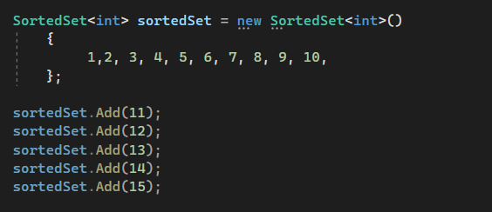
How to Add Elements into a SortedSet Collection
If you want to add elements to your SortedSet Collection, then you need to use the following Add() method of the SortedSet class.
Add(T item): This method is used to add an element to the set and returns a value that indicates if it was successfully added. The parameter item specifies the element to add to the set. It returns true if the element is added to the SortedSet object; otherwise, false.

Slide 5
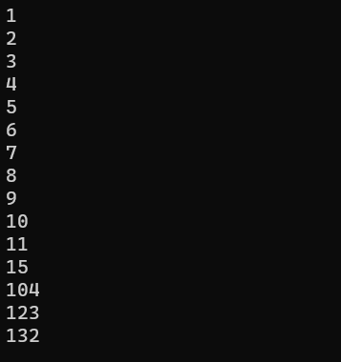
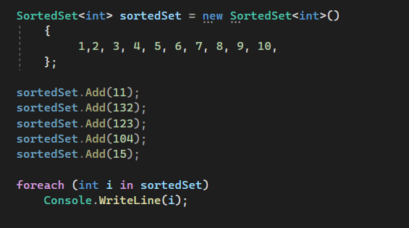
How to Access a Generic SortedSet<T> Collection
We can access the elements of the SortedSet<T> collection in C# using the ForEach loop as follows:

Slide 6
How to Remove Elements from a Generic SortedSet<T> Collection
The Generic SortedSet<T> Collection Class in C# provides the following three methods to remove elements from the HashSet.
Remove(T item): This method is used to remove the specified element from a SortedSet object. Here, the parameter item specifies the element to remove. It returns true if the element is successfully found and removed; otherwise, false. This method returns false if the item is not found in the Generic SortedSe collection.
RemoveWhere(Predicate<T> match): This method is used to remove all elements that match the conditions defined by the specified predicate from a SortedSet collection. It returns the number of elements that were removed from the SortedSet collection. Here, the parameter match specifies the Predicate delegate that defines the conditions of the elements to remove.
Clear(): This method is used to remove all elements from a SortedSet object.

Slide 7
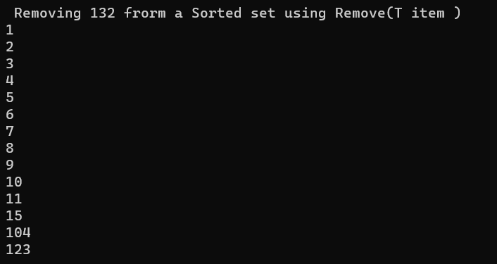
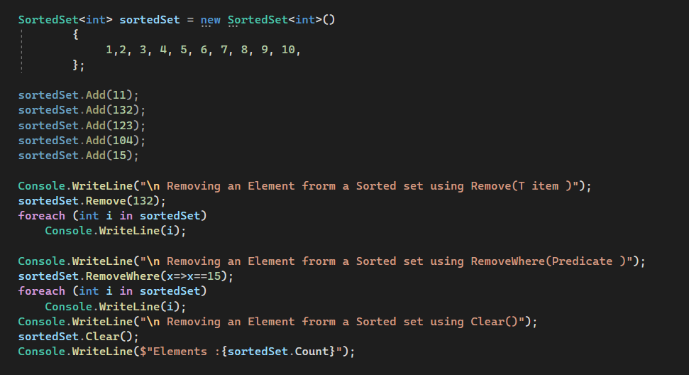
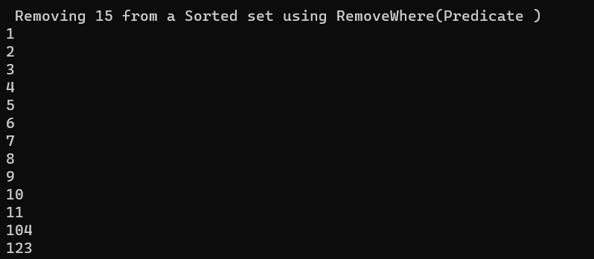

Slide 8
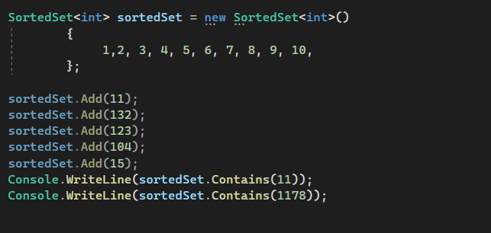

How to Check the Availability of an Element in a SortedSet
If you want to check whether an element exists or not in the SortedSet, then you can use the following Contains() method of the Generic SortedSet Collection Class in C#.
Contains(T item): This method is used to determine whether a SortedSet object contains the specified element. The parameter item specifies the element to locate in the SortedSet object. It returns true if the SortedSet object contains the specified element; otherwise, false.

Slide 9
Set Operations on Generic SortedSet<T> Collection
The Generic SortedSet Collection Class in C# also provides some methods that we can use to perform different set operations. The methods are as follows.
UnionWith(IEnumerable<T> other): This method is used to modify the current SortedSet object to contain all elements that are present in itself, the specified collection, or both. Here, the parameter other specifies the collection to compare to the current SortedSet object. If the parameter other is null, then we will get ArgumentNullException.
IntersectWith(IEnumerable<T> other): This method is used to modify the current SortedSet object to contain only elements that are present in that object and in the specified collection. Here, the parameter other specifies the collection to compare to the current SortedSet object. If the parameter other is null, then we will get ArgumentNullException.
ExceptWith(IEnumerable<T> other): This method is used to remove all elements in the specified collection from the current SortedSet object. Here, the parameter other specifies the collection of items to remove from the SortedSet object. If the parameter other is null, then we will get ArgumentNullException.
SymmetricExceptWith(IEnumerable<T> other): This method is used to modify the current SortedSet object to contain only elements that are present either in that object or in the specified collection, but not both. Here, the parameter other specifies the collection to compare to the current SortedSet object. If the parameter other is null, then it will throw ArgumentNullException.

Slide 10
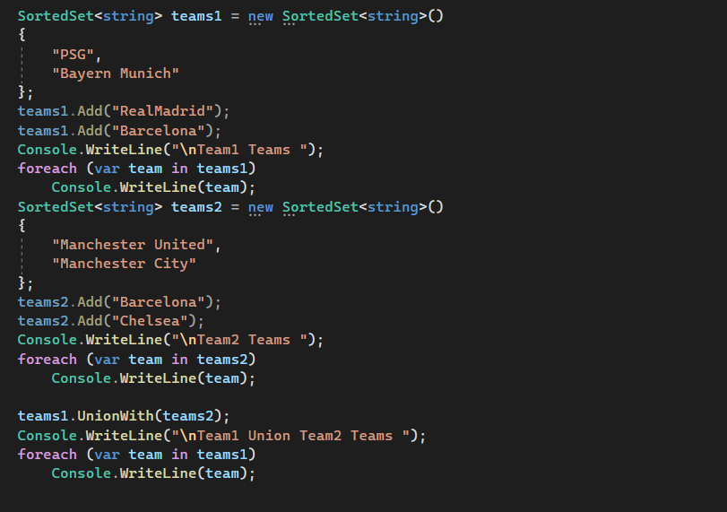
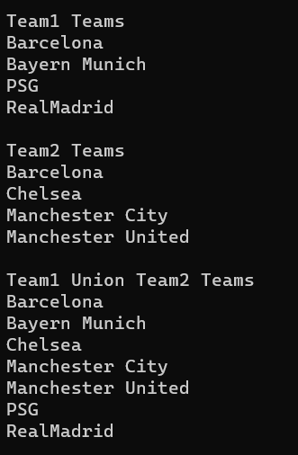
Generic SortedSet Collection UnionWith(IEnumerable<T> other)
UnionWith method will contain the elements which are present in both the collection by removing the duplicate elements

Slide 11
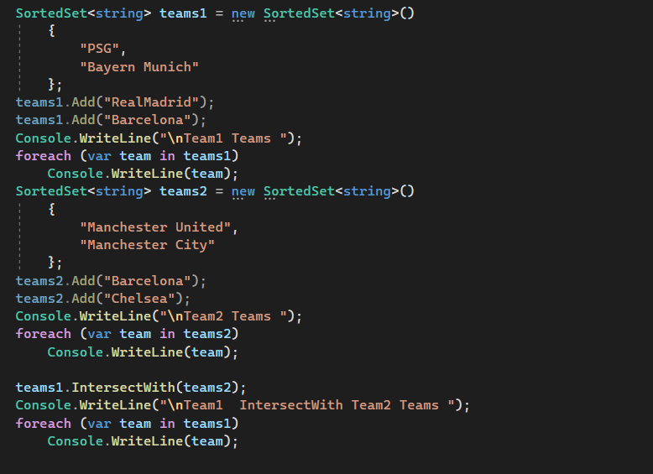
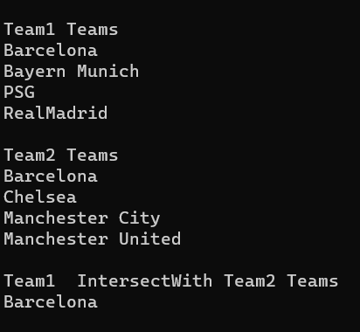
Generic SortedSet Collection IntersectWith(IEnumerable<T> other)
Here, you will see that the IntersectWith method will contain the common elements which are present in both the collection.

Slide 12
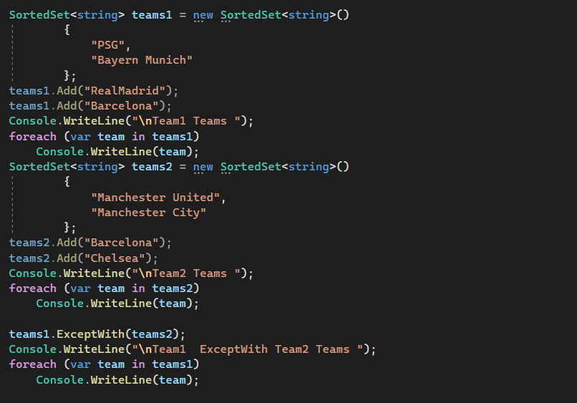
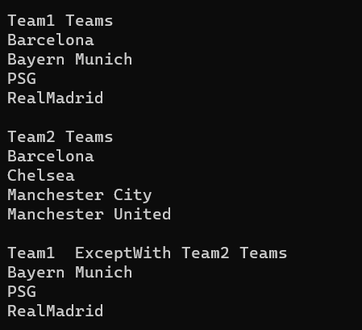
Generic SortedSet Collection ExceptWith(IEnumerable<T> other)
Here, you will see that the ExceptWith method will contain the elements from the first collection which are not present in the second collection.

Slide 13
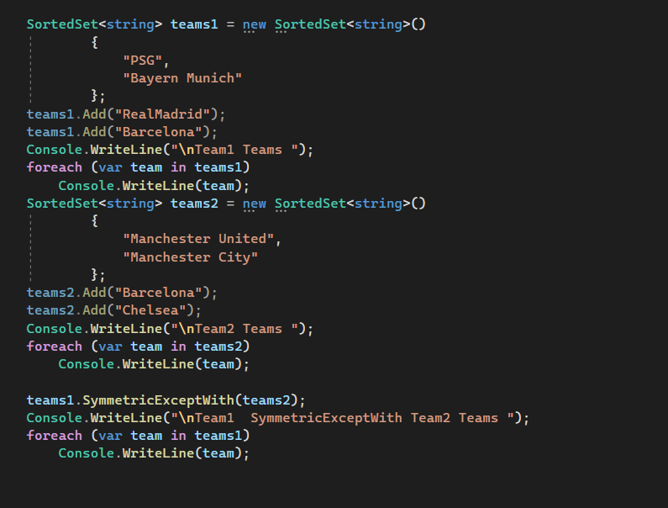
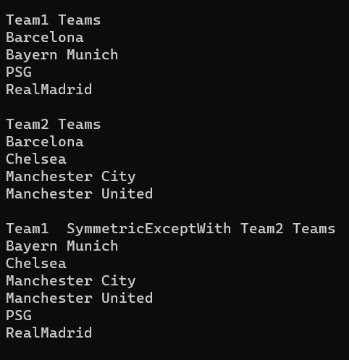
Generic SortedSet Collection SymmetricExceptWith(IEnumerable<T> other)
Here, you will see that the SymmetricExceptWith method will contain the elements which are not common in both collections.

Slide 14
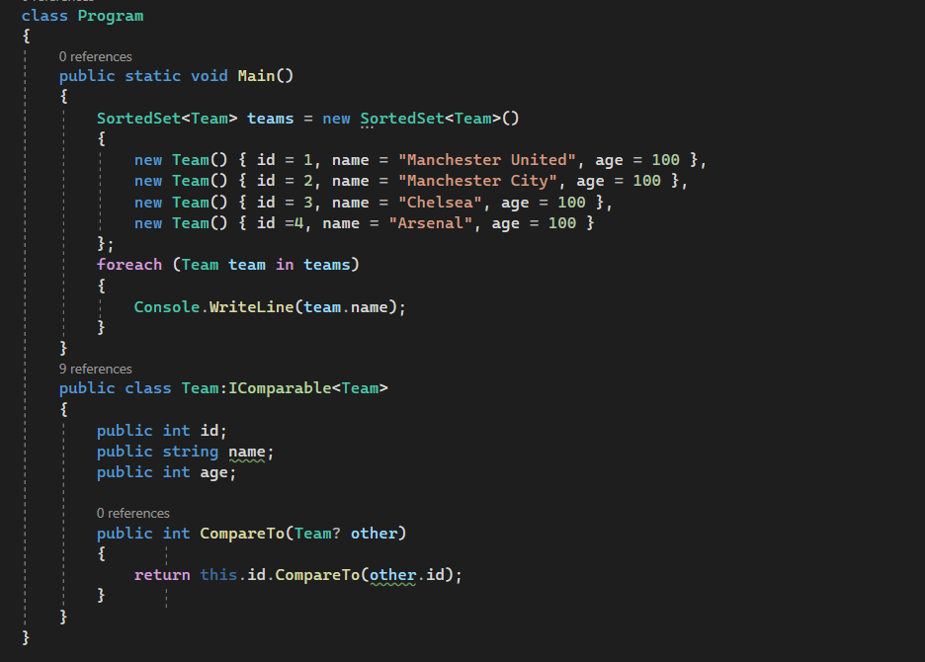

With custom Classes we should tell how to sort the elements by implementing the IComparable interface and providing an implementation for the CompareTo method

Slide 15
Generic SortedSet Collection Class Properties
Min: Returns the minimum value in the set
Max: Returns the maximum value in the set
Count: Returns the number of elements in the SortedSet.
Comparer: Returns the comparer that is used to order the values in the Generic SortedSet

Slide 16
Summary of Generic SortedSet<T> Collection Class
The Generic SortedSet<T> Collection Class implements the ICollection<T>, IEnumerable<T>, IEnumerable, IReadOnlyCollection<T>, ISet<T>, ICollection, IDeserializationCallback, ISerializable interfaces.
The capacity of a SortedSet<T> collection is the number of elements it can hold.
The Generic SortedSet<T> Collection provides many mathematical set operations, such as intersection, union, and difference.
It does not allow the addition of duplicate elements i.e. the elements must be unique in SortedSet<T>.
In SortedSet, the order of the element is ascending.
The Generic SortedSet<T> in C# is a dynamic collection. That means the size of the SortedSet is automatically increased when new elements are added to the collection.
As the SortedSet<T> is a Generic Collection, so we can only store the same type of elements.

